Slide 1
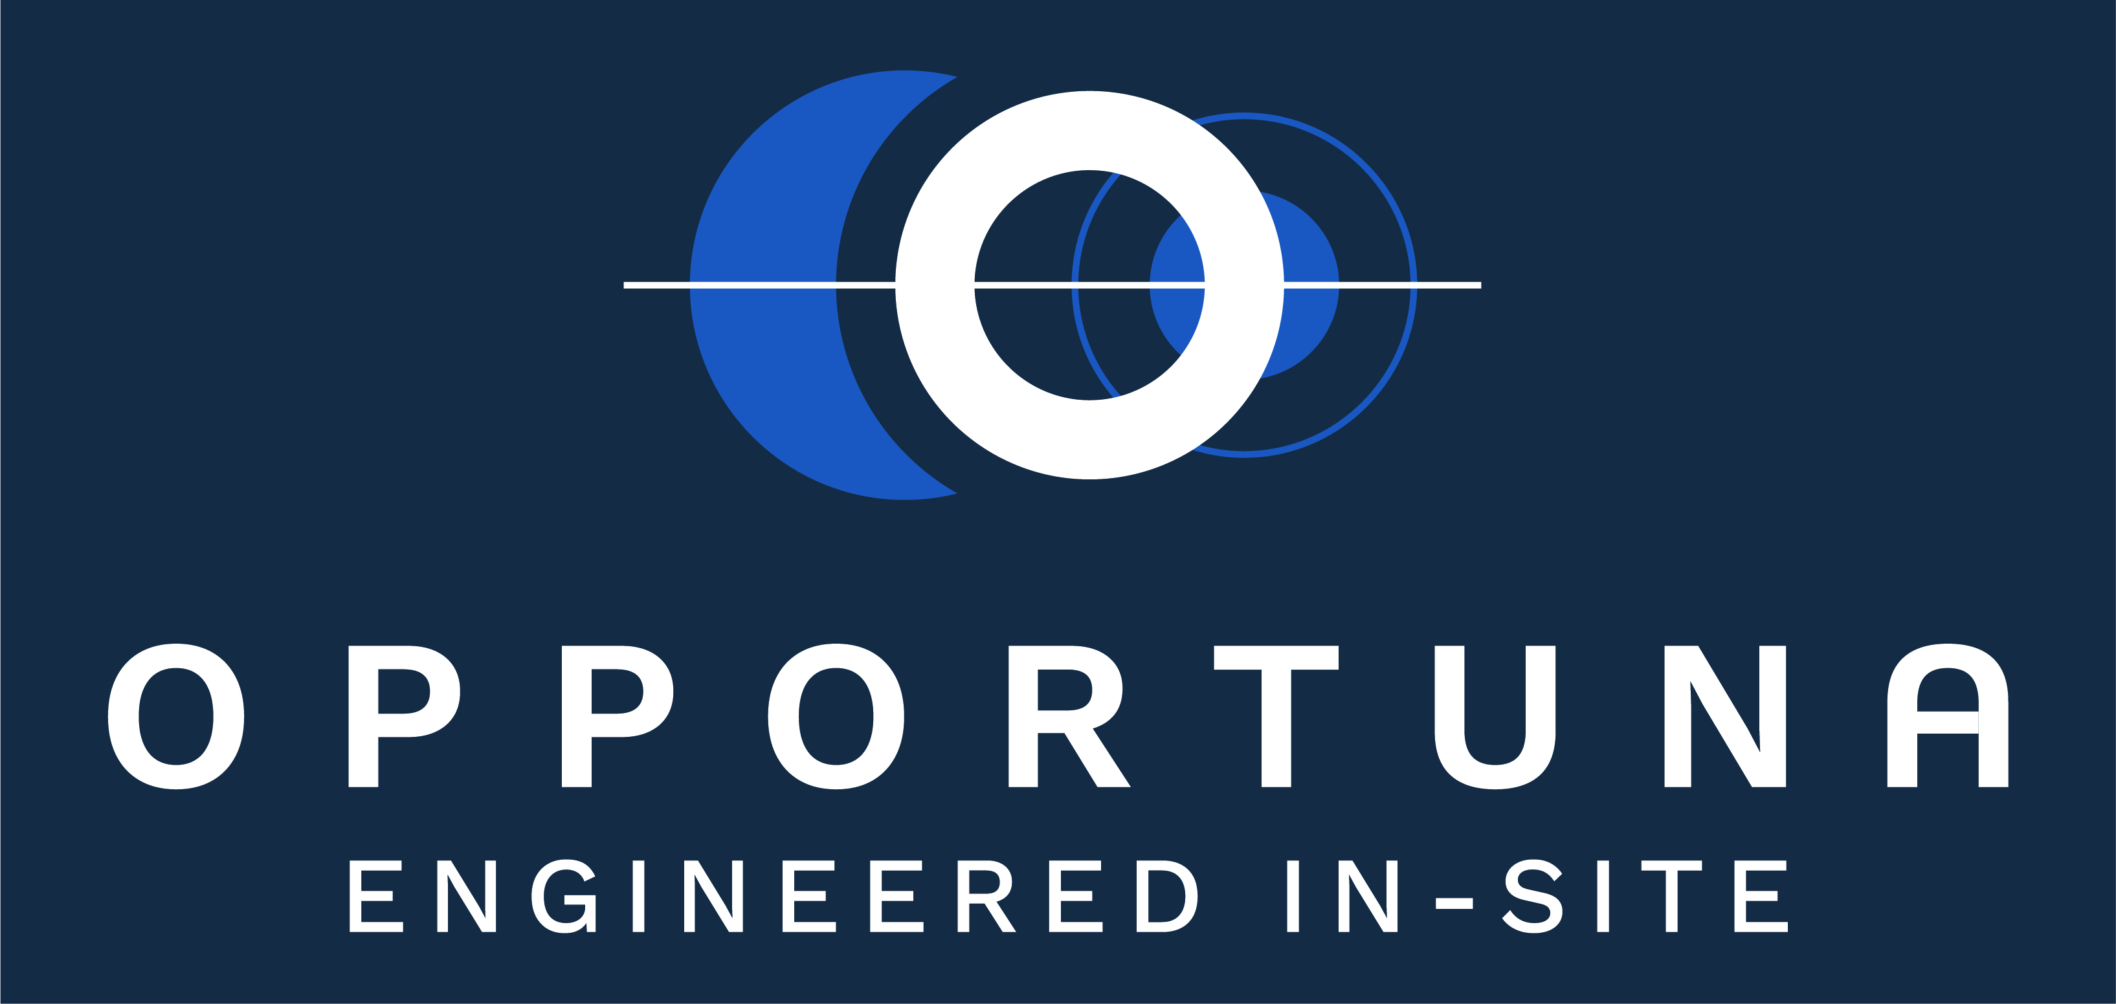
OPPORTUNA UNDERWRITING MANAGERS

Slide 2

What is an Engineering policy
Engineering Insurance is an insurance policy that covers a wide range of engineering related risks. It is a comprehensive insurance that provides complete protection against risks associated with erection, resting and working of any machinery, plant or equipment.
Types of Engineering Covers
CAR/ EAR/ Contract Works
Dismantling, Transit and Erection (DTE)
Plant All Risk (including Plant Hirers)
Machinery Breakdown
Loss of Profits following Machinery Breakdown
Deterioration of Stock following
Electronic Equipment
Contract Plant Liability
Contractors Liability
Lateral Support Liability
Road Risk Liability
Political Violence and Terrorism

Slide 3
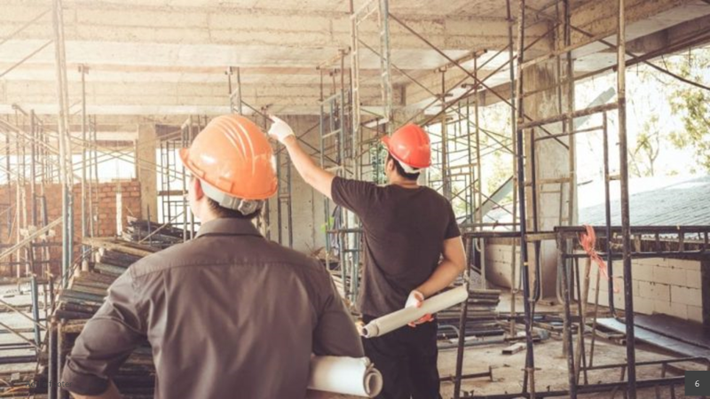
When Engineering Insurance is Essential
Explosion risks
Engineering insurance is essential to provide full cover for explosion risks. The peril ‘explosion’ in material damage cover provides only limited cover and excludes damage caused by any steam-pressured vessel.
Electrical breakdown
Insurance cover for electrical breakdown is essential where computers are involved. The policy can cover sudden and unforeseen loss or damage to the computer installation, the increased cost of working arising from such damage and the reinstatement of any data lost as a result of the breakdown.

Slide 4
Engineering policies can be written either on a Once Off or Open Annual
Contractors All Risk Once Off
This Contractors All Risk Insurance policy is taken on a once-off basis. When you are awarded a tender, we will provide you with quote for cover on that specific project based on it’s value and risks. The cover will end when the project is complete.
Contractors All Risk Annual
This Contractors All Risk Insurance policy is slightly more comprehensive than the once off policy. You will be quoted on your Annual Projection and Maximum Contract Value. The Contractors All Risk Insurance policy will cover all your projects undertaken in the year of the policy inception. The premium is generally lower than the Contractors All Risk Once Off policy if you work it out annually.

Slide 5
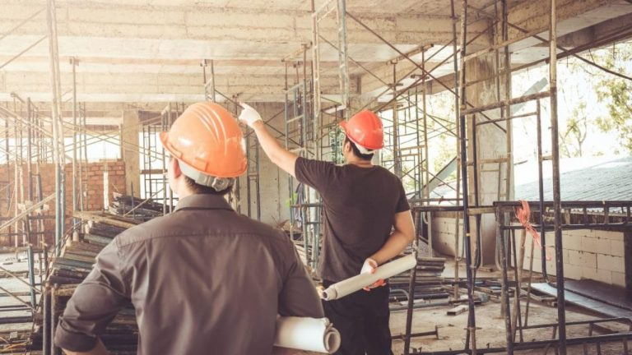
CONTRACT ALL RISK (CAR)
Contractors' all risks (CAR) insurance is a non-standard insurance policy that provides coverage for property damage and third-party injury or damage claims, the two primary types of risks on construction projects.
Damage to property can include improper construction of structures, the damage that happens during a renovation and damage to temporary work erected on-site.
Third parties, including subcontractors, may also become injured while working at the construction site.
CAR insurance coverage is common for such construction projects as buildings, water tanks, sewage treatment plans, flyovers, and airports.
Risks often covered under a CAR policy include flood, wind, earthquakes, water damage, and mold, construction faults and negligence; they typically do not cover normal wear and tear, willful negligence or poor workmanship.
Contractor’s All Risk Insurance is a policy which insures the principal/employer and covers the contract works undertaken by the contractor and sub contractors.

Slide 6
CAR/ EAR/ Contract Works
CAR coverage provides protection for construction or contractor all risks and is used mainly for the movement of dirt and concrete building work. CAR is more suitable for civil works such as buildings, roads, bridges, and docks.
EAR coverage is applied to the use of installing machinery and equipment. EAR is more suitable for engineering facilities and other construction projects involving erections and installations. For example, EAR insurance policies provide coverage for the construction of power plants, gas processing facilities and others.
The Contractors All Risk Insurance Policy covers the following risks:
The Contract works
Spread of Fire
Theft
Flooding
Earthquakes
Landslides
Surrounding property
Debris removal
Public liability
Transit and Storage Limit
Theft of Cables
Piping & Wiring and more on request.
Annual policies also allow the addition of Plant All Risk Cover.

Slide 7
To get a quote we will need the following details:
Contract Period
Contract Value
Client and Principal details
Description of all activities carried out
Public Liability Limit
Turnover of contractor
Bill of Quantities
Breakdown of Costs

Slide 8
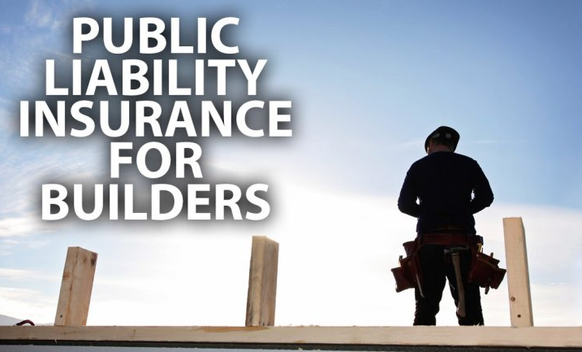
Contractors All Risk Public Liability
Public Liability Insurance does not cover property under care, custody and control.
As such, any damage to your client’s property is covered under Surrounding Property.
You may need cover for situations where members of the public or people who are not employed by your company enter your premises/ Construction site and get injured.

Slide 9
Lateral Support Liability
Lateral support means, physical support to prevent sideways movement.
If an excavation done by adjoining owner damage landowner’s property, the adjoining owner is liable for the damages.
When the adjoining owner excavate into the soil for foundation, basement or leveling, a retaining wall is to be constructed to prevent a collapse.
The most common need for lateral support is in the construction of deep basement excavations.

Slide 10
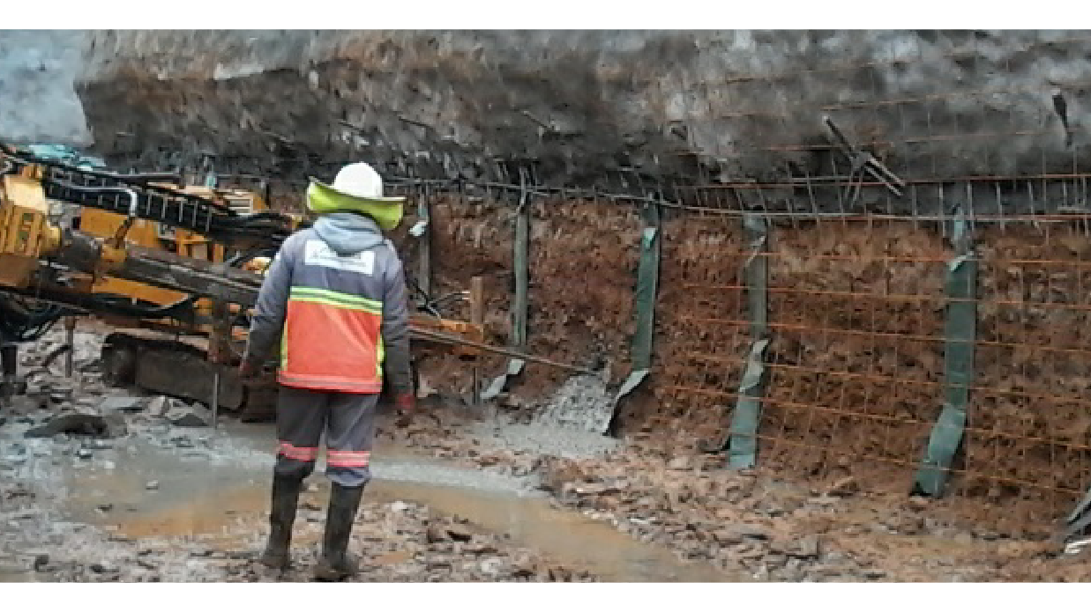

Slide 11
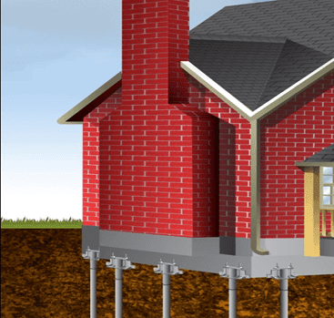
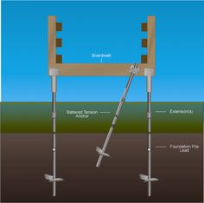

Slide 12
Dismantling Transit & Erection Insurance
Cover can be provided on specific contract basis for loss or damage to new or existing electrical and mechanical equipment during machine moving operations, from dismantling the plant, loading and transporting plant to site, positioning including lifting operations and thereafter during installation and assembly of the equipment. The cover extends to loss or damage to the equipment being moved provided that the value of such equipment (either market value or new replacement value) is included in the policy sum insured. Cover in respect of testing is limited to new equipment.
The cover can be provided on an annually renewable policy, provided always that the value of every contract including the value of equipment being moved is declared and noted in the policy schedule.
Dismantling, transit and erection insurance covers the physical loss of or damage to plant and machinery during the operation insured.
This policy can include cover for dismantling, movement, loading, transit, offloading, storage, repositioning, re-erection, public liability and maintenance.
Cover can be limited to any or all of the above mentioned as required and can be adopted to suit most operational requirements.

Slide 13
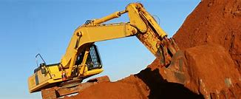
Plant All Risks Insurance
Plant All Risks Insurance is an insurance policy that covers mostly mobile plant and machinery items against unforeseen physical loss or damage that may arise from the occurrence of perils that are not specifically excluded from the cover.
This type of cover will cover items such as earthmoving equipment, cranes, pumps, air compressors etc.
The basis of indemnity can either be new replacement value, market related value or agreed value depending on the age and type of items and taking into account the specific requirements of the insured.
It is critical that :
Your PAR Sum Insured right
Correct basis of settlement is very important in order to provide suitable sums insured.

Slide 14
The following sections of cover are available:
Material Damage – Own Plant
Hiring Costs
Legal liability and continuing hire charges (Hired-In Plant)
Site Liability
Third Party Liability for road licensed vehicles
Loss of or damage to construction plant and equipment from any cause whilst in storage, transit, on contract site and being use as a tool of trade.
Third Party Liability for Plant on site and on the road for licensed plant.
This policy will cover risks such as fortuitous working accidents, theft, fire, faulty operation, overturning as well as natural perils such as earthquake, storm, flood, collision etc.

Slide 15
There are three bases of determining sums insured, namely:
1. New Replacement Value (“NRV”)
Reinstatement basis claim settlement will result in an improvement to the insured’s position.
Reinstatement will cover either:
Cost of repair, with no deductions made for wear, tear, depreciation or other forms of obsolescence
Cost of replacing the asset with a new item of similar type, capacity and utility (i.e. ‘new for old’)
NRV requires input from your dealer / supplier as to the new replacement value and average applies if the sum insured is less than the cost to replace the new item which includes VAT and delivery costs.
Since values need to be updated regularly makes it difficult to establish and maintain the NRV.

Slide 16
2. Agreed Value (“AV”)
AV is a value agreed between the insurer and insured. AV does not attract Underinsurance (Average).
AV indemnity basis return the insured to their position prior to the loss – no more, no less.
An indemnity basis will cover either:
Cost of repair, less an allowance for wear, tear, depreciation and all relevant forms of obsolescence.
Cost of a replacement with a similar machine, giving regard to its age and condition and all relevant forms of obsolescence.
The basis of insuring AV has the following challenges these being that the insurer will not pay more than the Market value even if a value has been agreed resulting often in over insurance and betterment is applied if old parts are not available.

Slide 17
3. Market Value (“MV”)
The sum insured must be equal to the market value of the item and average applies if underinsured
MV indemnity basis return the insured to their position prior to the loss – no more, no less.
An indemnity basis will cover either:
Cost of repair, less an allowance for wear, tear, depreciation and all relevant forms of obsolescence
Cost of a replacement with a similar machine, giving regard to its age and condition and all relevant forms of obsolescence
A settlement on this basis is therefore unlikely to fund the full cost of a new replacement asset, so you should be particularly conscious of overstating sums insured.

Slide 18
The following extensions can typically be added to a PAR policy:
Third Party Road Risk Liability : (ONLY For Plant that are registered for road use)
Road risk liability for plant all risk covers you for any accident that’s caused by, through, or in connection with, the vehicles stated on your policy schedule.
Construction Site Liability Cover
Public liability for plant all risk covers losses and damages caused by your insured plant all risk items, whether you own them, or whether they’re hired-in or -out.
Recovery costs – extraction and towing
Hired in plant – cover for your legal Liability that may arise from the Plant that you hire.
Continuing Hire Charges – cover if plant has been hired and is accidentally damaged
SASRIA – special risks cover, including riots, terrorism, war, etc.
Windscreen damage / loss

Slide 19
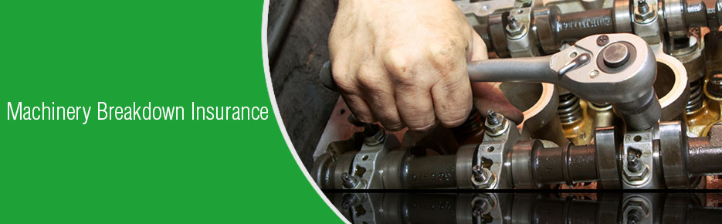
Machinery Breakdown and Business Interruption
Cover can be provided for the costs to repair sudden and unexpected failure of electrical and mechanical production machinery (using new parts) and can be extended to cater for loss of profit while the machinery is being repaired following an event insured in terms of the machinery breakdown policy. In addition to the policy cover extends to include provision for breakdowns caused by operator error and ingress of foreign objects.
The Machinery Breakdown cover can also be extended to loss of product (raw material in process) which was being processed when the machine broke down and Deterioration of Stock in cold storage, following breakdown of the refrigeration equipment.
Machinery Breakdown Insurance covers the sudden and unforeseen physical damage to machinery and plant arising from mechanical or electrical breakdown, whilst in operation, at rest, or during resitting or re-erection at the client’s premises.
This cover is subject to an appropriate, scheduled machinery maintenance program being in place and carried out by suitable persons.
The following sections of cover are available:
Physical Damage to Machinery
Deterioration of Stock
Loss of Gross Profit, Loss of Revenue or Additional Increase in Cost of Working

Slide 20
Loss of Profits following Machinery Breakdown
Machinery breakdown loss of profit insurance is a policy that covers the loss of profit following machinery breakdown insurance against loss of profit or increase in cost of working resulting from an interruption or interference to the business following loss destruction or damage to any insured building or property.
What is covered
The continuing business expenses (standing charges)
The net profit
The salaries and wages paid to employees
The increase in cost of working i.e. the additional expenditure necessarily and reasonably incurred for avoiding or diminishing a reduction in turnover.

Slide 21
Deterioration Of Stock (D.O.S) Following Machinery Breakdown
Suitable for all types of frozen and chilled goods and products
Cover Provided
Loss or Damage occurring to frozen and chilled goods and products in Cold Storage due to Sudden and Unforeseen Breakdown of Refrigerant Machinery
Subject Matter
This policy can include:
Frozen meat
Chilled Vegetables and fruits
Other frozen and chilled food
Medicine and plasma

Slide 22

Electronic Equipment Insurance
Electronic Equipment Insurance covers the physical loss or damage to computer and electronic data processing equipment and associated ancillary equipment arising from fire and allied perils, accidental damage, malicious damage, theft and machinery breakdown.
This policy can also be extended to cover:
Increased Cost of Working
Reconstitution of Data
Loss of or damage to Computer and Electronic Data Processing Equipment , IT installations, telephone exchanges, cell phone networks and associated ancillary equipment arising from Fire and Allied perils. Accidental Damage, Malicious Damage and Machinery Breakdown. The basic policy can be extended to cover Increased Cost of Working. Reconstitution of Data and losses arising from the failure of electricity supply and Telkom land line.

Slide 23
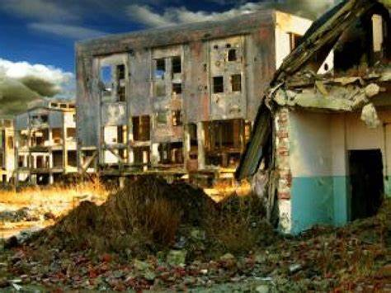
Political Violence and Terrorism
Terrorism and political violence ( PVT) insurance covers an individual or company against physical loss and damage, as well as business interruption costs, as a result of a terrorist act or acts of political violence such as riot, strike, civil commotion, revolution, war, civil war, rebellion, insurrection, sabotage, coup d’état and malicious damage, and consequential looting.
It can occur as a stand-alone cover or as part of another policy such as Motor Vehicle insurance or Home Insurance commonly called a rider.
Why you need PVT?
Every so often, parts of the world are reminded of the threats posed to people, businesses and property by acts of violence motivated by political or terrorism forces.
Politically motivated attacks, acts of terrorism and other forms of unrest can cause great losses to businesses and individuals and loss of lives.
It is vital during such times to have a way to adequately protect assets, people, and plan for business continuity.
Apart from other key security prevention tactics, insurance remains a key tactic to manage the exposure.

Slide 24
What does PTV cover
Terrorism and sabotage
Riots, strikes and civil commotion and malicious damage
Insurrection, revolution and coup d’etat
War and civil war
Employee and general terrorism liability
Chemical, Biological, Radiological & Nuclear (CBRN)
CBRN Liability
Active Assailant
Auto Terror
Loss of Attraction -
Threat
Useful tips on Terrorism and political violence
Although we all do not wish any acts of violence, they occur and it’s best to manage the risk.
Like all other insurance contracts read the policy document well and seek interpretation in areas that appear difficult.
Look at an insurers ability to pay your claims through their capacity, reputation and experience in each area.

Slide 25
What is not covered under Political Violence and Terrorism
Loss or damage arising from nuclear, chemical, biological or radiological (NCBR) attacks, although limited and expensive capacity is available upon request
Loss or damage caused by confiscation, nationalization, or any result of any order of public or government authority which deprives the insured of the use or value of its property
Loss or damage by electronic means: cyber / computer hacking, although as with NCBR coverage, there are standalone products being developed
Business interruption as a result of a threat or hoax.
BENEFITS AND SERVICES
Certainty of stand-alone coverage
Global insurance coverage for terrorism, war and political violence
Primary, excess or quota share participation
Standard market or bespoke wordings
Global capability, with underwriting hubs in London, Singapore and the US
Specialized underwriters who understand applicable legislation like Terrorism Risk Insurance Program Reauthorization Act (TRIPRA)

Slide 26




Thank You
Maureen Nxumalo
063 575 6543
Maureen@opportunaum.co.za

